Slide 1







Capstone Project Defense
Software Engineering (ABET), Management Information System (ABET) & Network Security
Danang, 25 - 28, May 2023

Slide 2



CMU-SE 451
Craft Village Pollution Monitor System
Capstone Project Defense
25.05.2023
C2SE.01

Slide 3

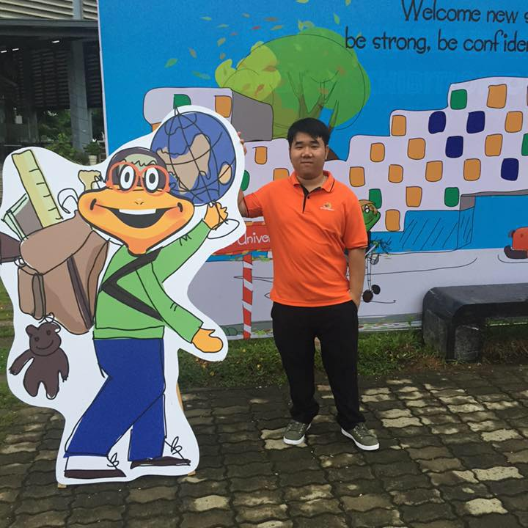
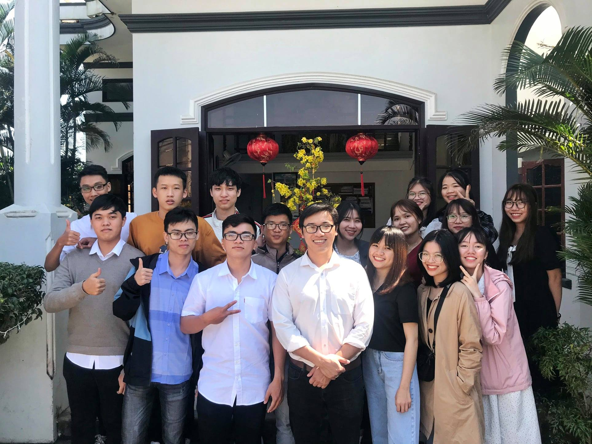
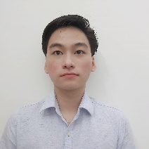

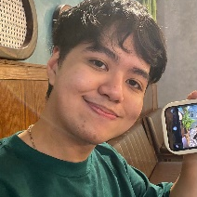
VAN CONG LE CA
Scrum Master, Mobile Developer
BUI DUC HUY
AI Developer
MEMBERS
HUA HOANG PHUC
“Be part of the solution, not part of the pollution.”
Backend Developer, Database Administrator
NGUYEN THANH TRUNG
Frontend Developer
HUYNH BA NHAN
Dr. NGUYEN THANH BINH
Frontend Developer, Server Administrator

Slide 4
01
THE ISSUE
02
RESOLVING STRATEGY
CONTENTS
03
TECHNOLOGICAL ASPECTS
“The greatest threat to our planet is the belief that someone else will save it.”
04
MANAGEMENT APPROACH
05
DEMONSTRATION

Slide 5
01
THE ISSUE
“The earth is what we all have in common.”

Slide 6




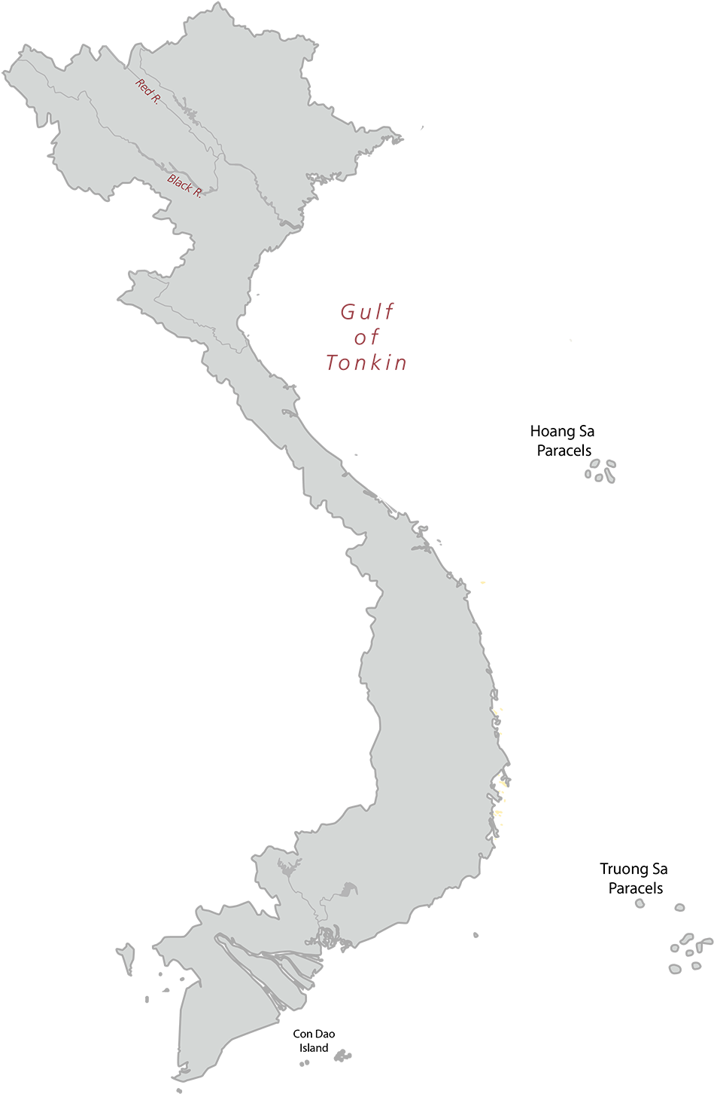
THE ISSUE
Red River Delta
Nationwide
800
1450

Slide 7
THE ISSUE

Slide 8
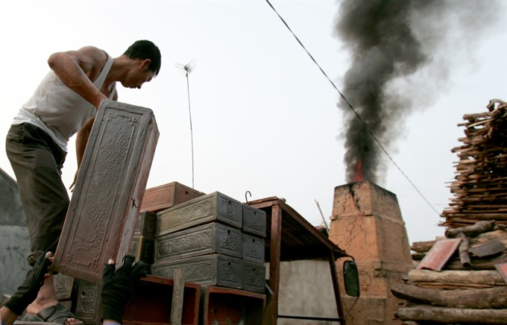
THE ISSUE
01
CUMBERSOME PROCESS
The current process for reporting pollution is often cumbersome and time-consuming, hindering effective action and timely response.
02
UNFRIENDLY USER SYSTEM
The user system for monitoring pollution is often characterized by an unfriendly interface, hindering effective data access and analysis.
03
LACK OF EFFECTIVE TOOLS
The lack of an effective tool to monitor pollution hinders accurate assessment and timely mitigation of environmental risks.
04
INSUFFICIENT DATA
The lack of sufficient data to monitor pollution limits our understanding of its extent and impact on the environment.

Slide 9
02
RESOLVING STRATEGY
“We do not inherit the Earth from our ancestors; we borrow it from our children.”

Slide 10


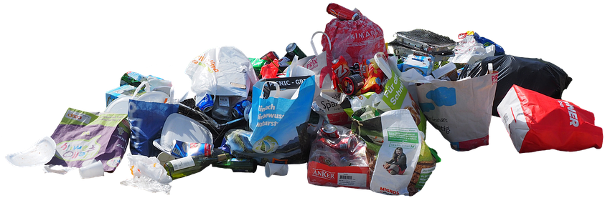

RESOLVING STRATEGY

Slide 11








RESOLVING STRATEGY

Slide 12
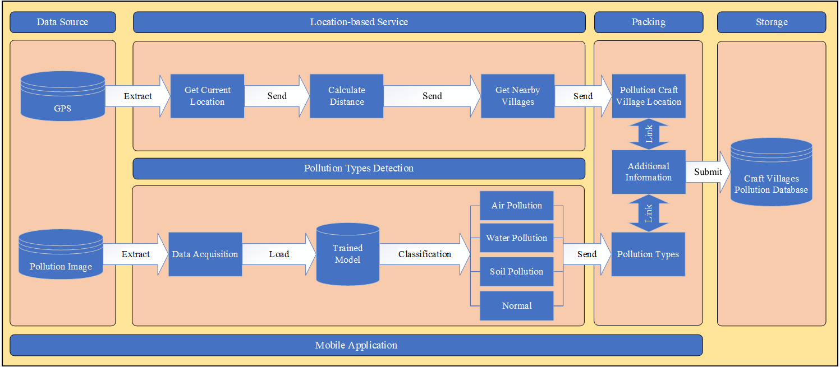
RESOLVING STRATEGY

Slide 13
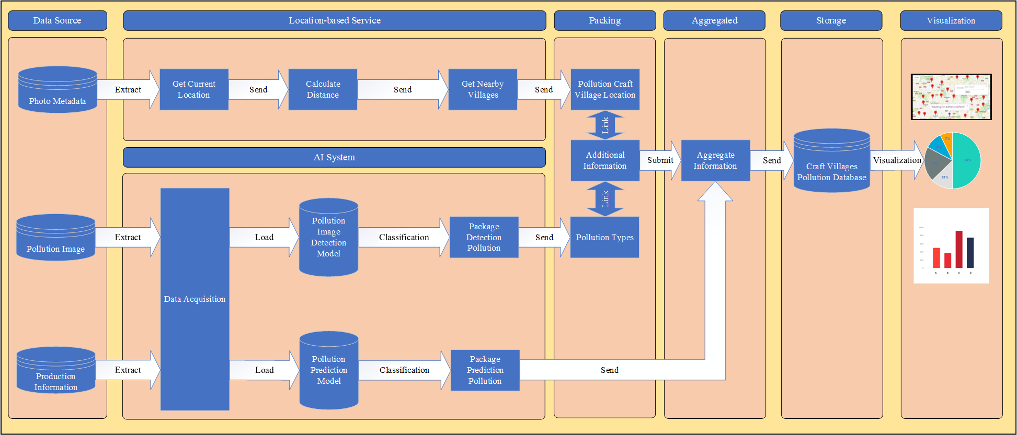
RESOLVING STRATEGY

Slide 14

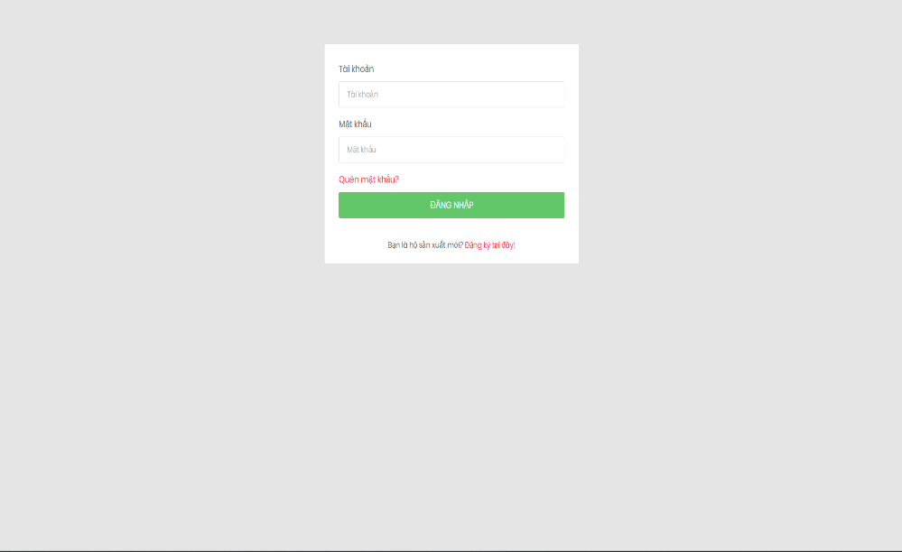

RESOLVING STRATEGY
01
POLLUTION PREDICTION AI
The pollution prediction AI utilizes production input data to accurately identify and classify different types of pollution.
02
PHOTO METADATA FOR LBS
By utilizing photo metadata, pollution location can be effectively extracted, enabling precise mapping of pollution sources.
03
EFFICIENT MONITORING TOOL
An efficient monitoring tool capable of identifying and tracking various pollution types along with their corresponding locations.

Slide 15
03
TECHNOLOGICAL ASPECTS
“The Earth is a fine place and worth fighting for.”

Slide 16
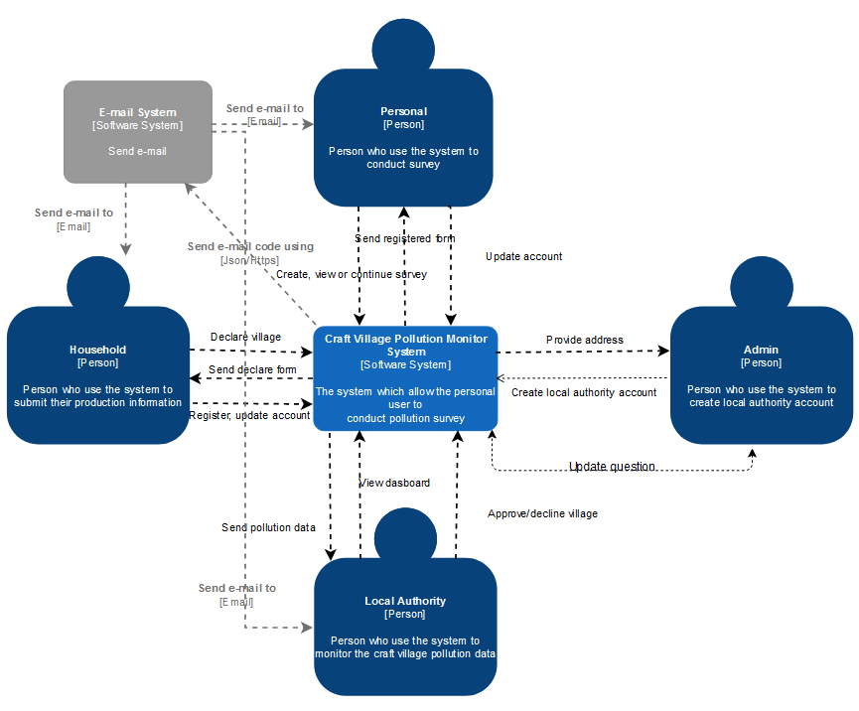
SYSTEM CONTEXT DIAGRAM

Slide 17
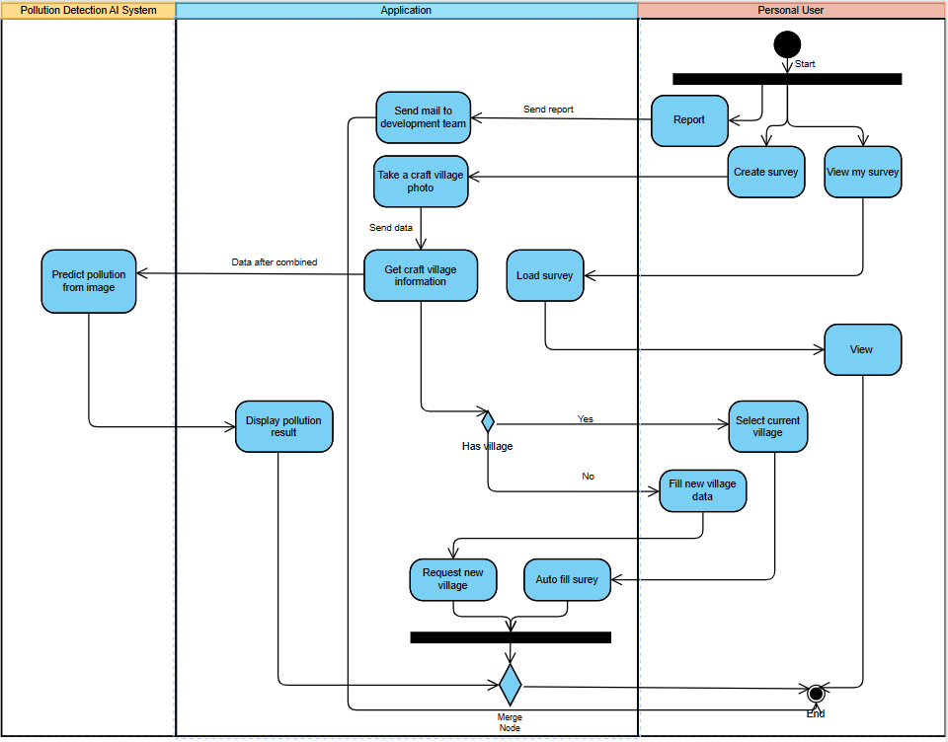
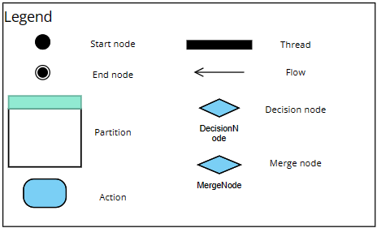
ACTIVITY DIAGRAM

Slide 18
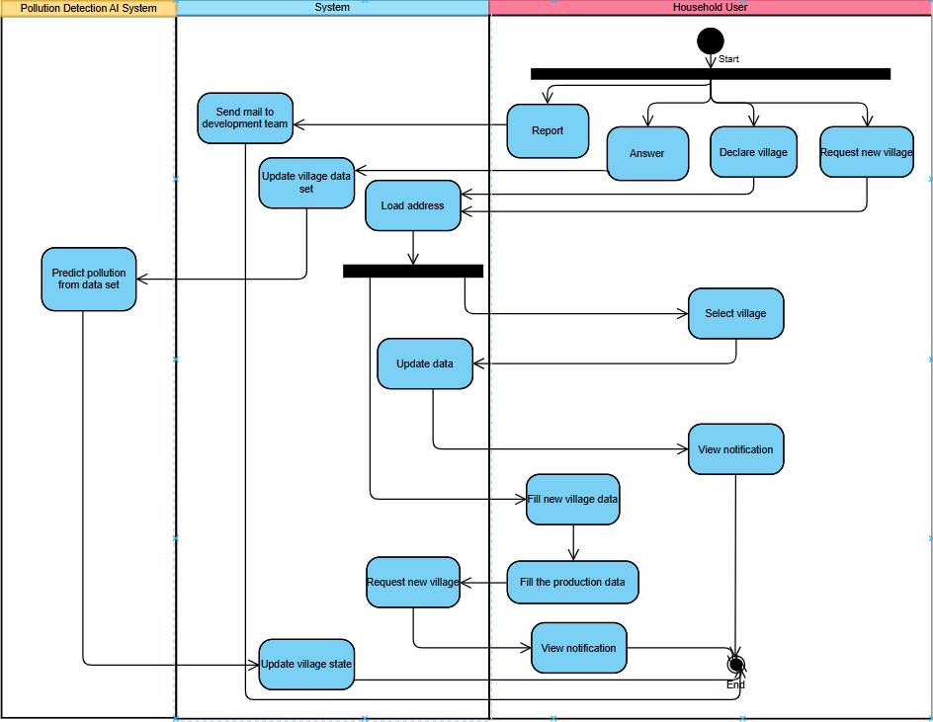
ACTIVITY DIAGRAM

Slide 19
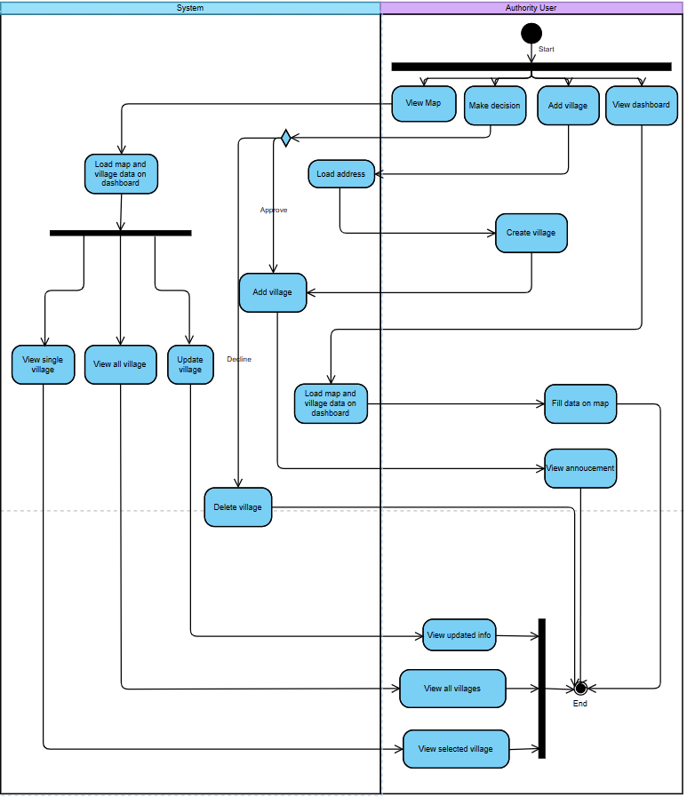
ACTIVITY DIAGRAM

Slide 20
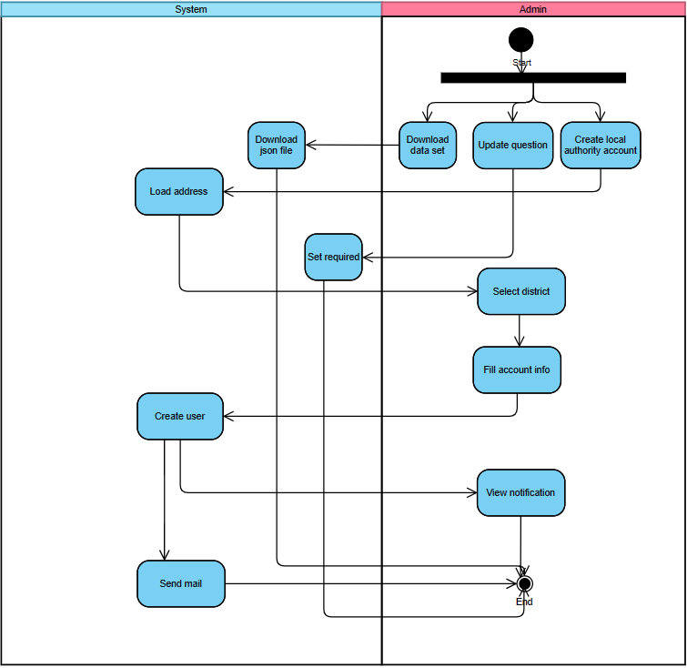
ACTIVITY DIAGRAM

Slide 21
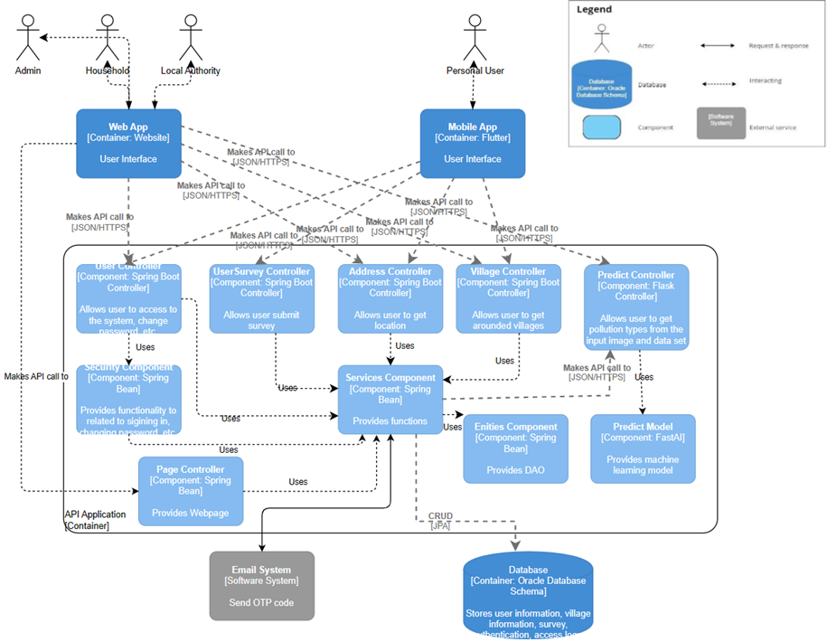
C&C VIEW

Slide 22
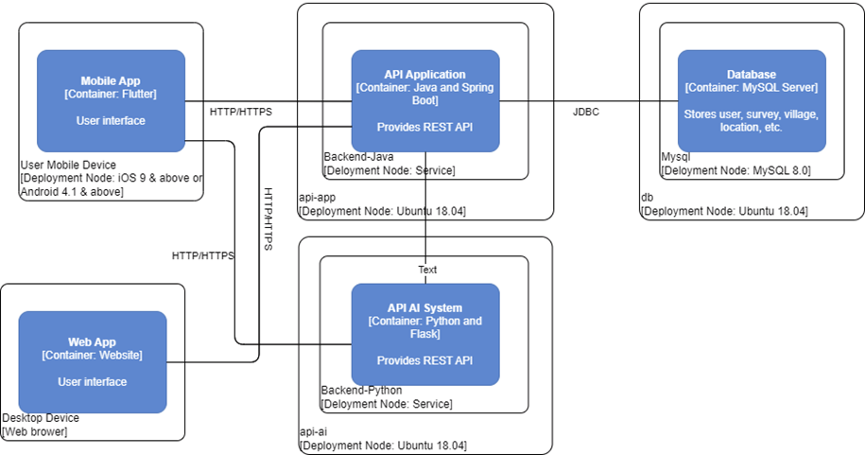
ALLOCATION DIAGRAM

Slide 23
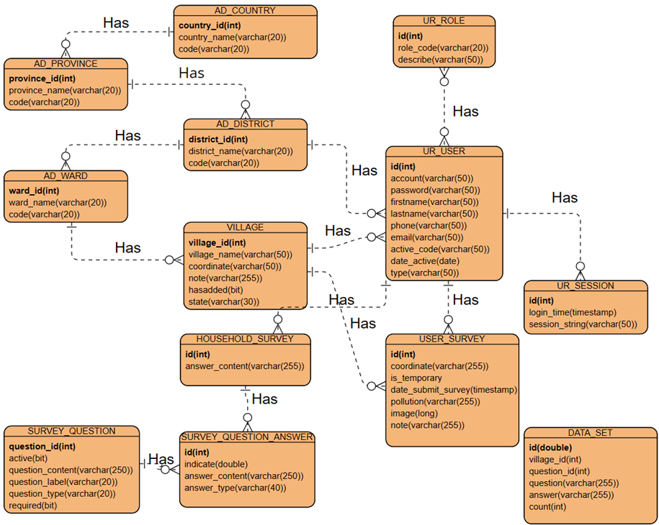
ENTITY RELATIONSHIP DIAGRAM

Slide 24
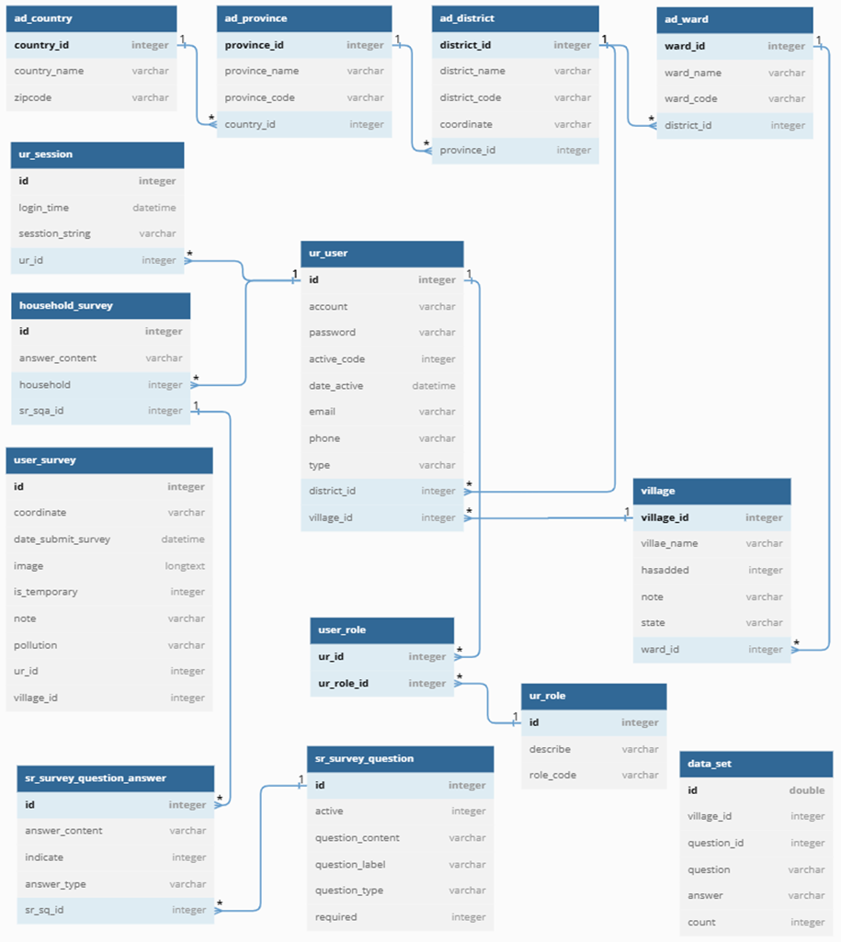
DATABASE STRUCTURE

Slide 25











TECHNOLOGIES
CLIENT SIDE | SERVER SIDE | DATABASE

Slide 26
EXIF STANDARD
COMPATIBILITY
METADATA STORAGE
EXIF metadata is compatible with a wide range of image file formats, including JPEG, TIFF, and RAW.
The EXIF standard allows for the storage of various types of metadata within image files.
EXTENSIBILITY
STANDARDIZED
STRUCTURE
The EXIF standard is designed to be extensible, allowing for the inclusion of custom or specialized metadata fields.
The EXIF standard ensures consistent metadata storage, enabling easy extraction and interpretation across devices.

Slide 27
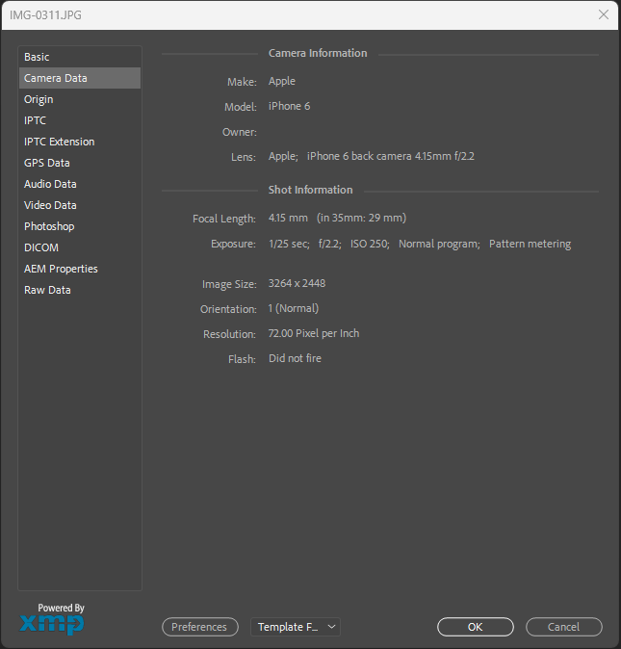
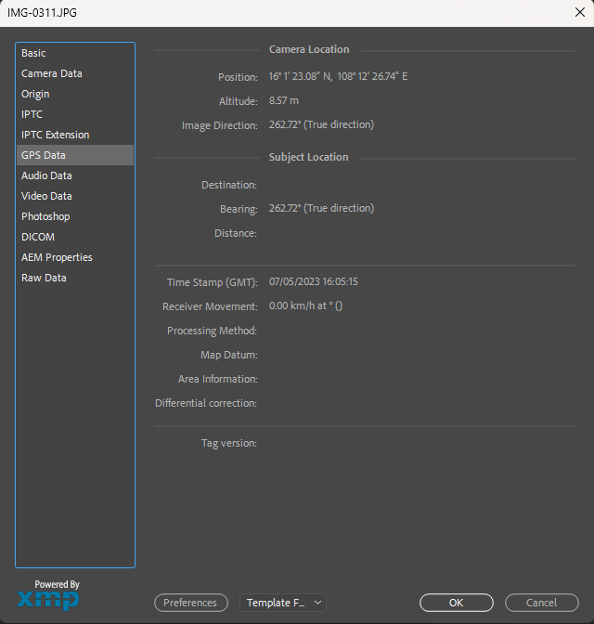
LBS USING PHOTO METADATA

Slide 28
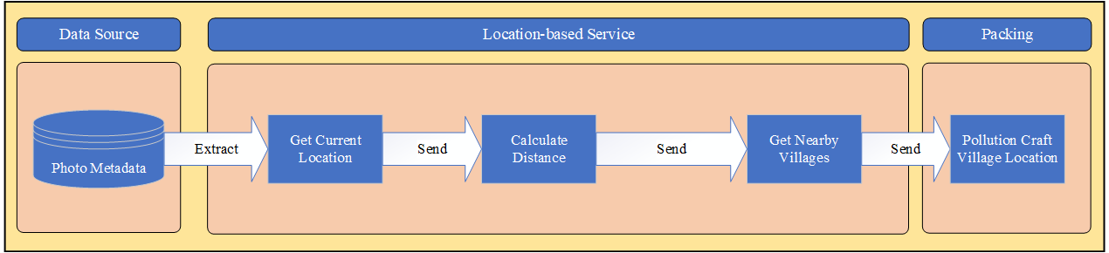
LBS USING PHOTO METADATA

Slide 29
POLLUTION DETECTION AI
DATA
PRE-PROCESSING
SOLUTION
TRAINING
The solution involves implementing a multilabel classification approach to accurately categorize and label various pollution types.

Data pre-processing is crucial in multilabel classification for enhancing pollution type prediction accuracy.

Training is a fundamental step in multilabel classification to optimize the model for accurate pollution type prediction.
In the training phase of our machine learning model, we leverage a carefully curated dataset along with the powerful pre-trained ResNet34 model. By feeding the model with a diverse range of input images, we enable it to learn and predict multiple pollution classes with high accuracy and reliability. This training process forms the foundation for our robust and effective pollution detection system.

Slide 30
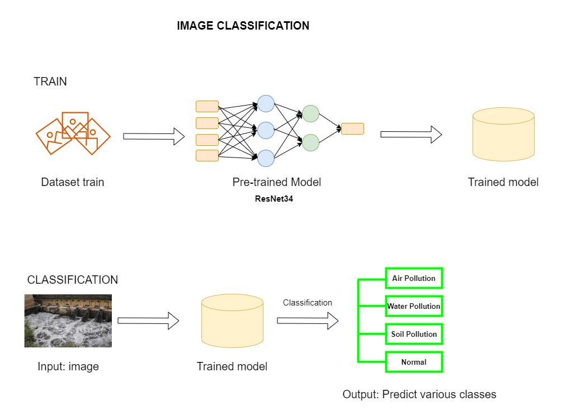
POLLUTION DETECTION AI

Slide 31

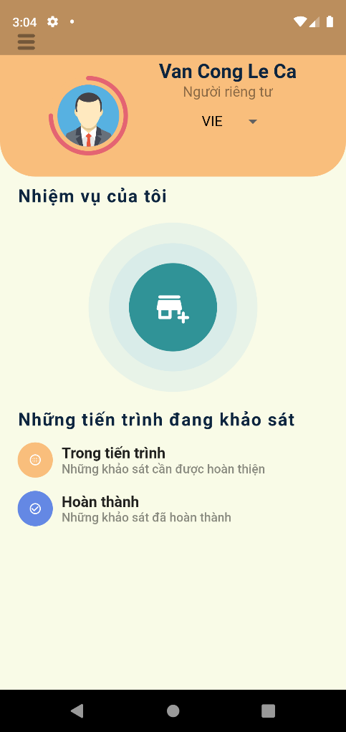
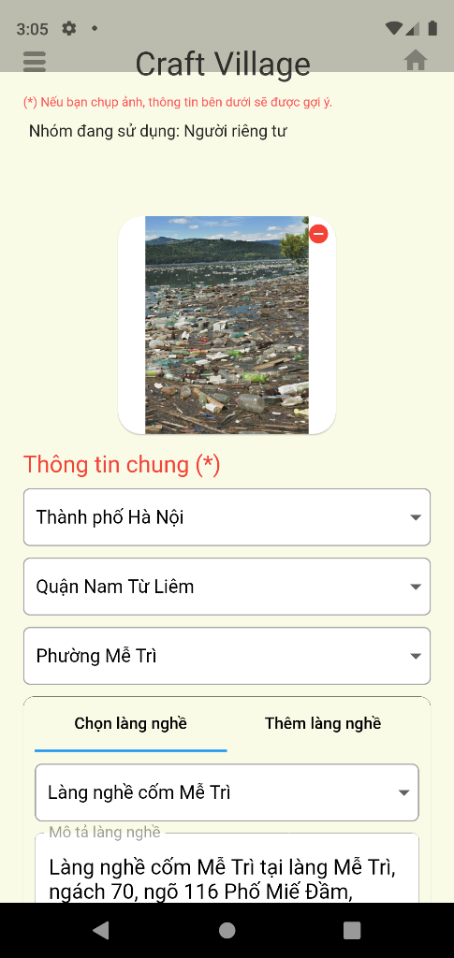
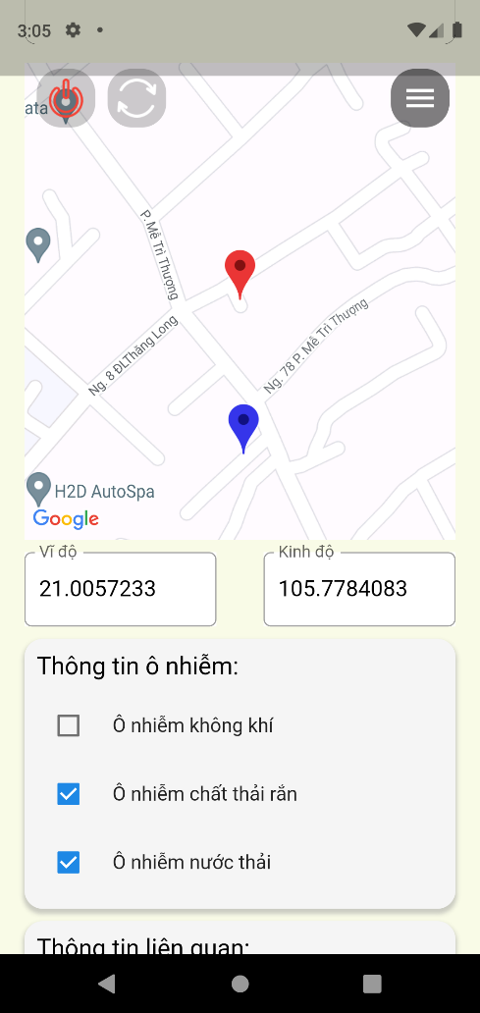

Slide 32
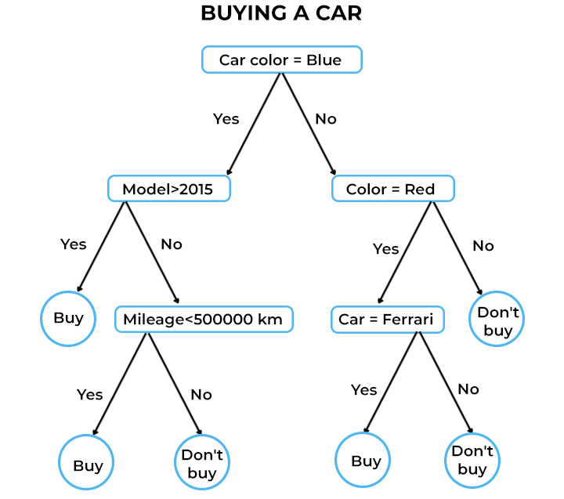
DECISION TREE

Slide 33
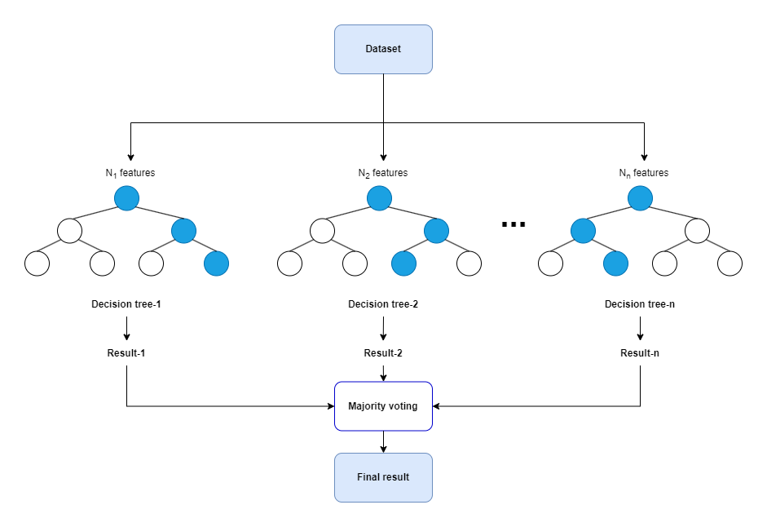
RANDOM FOREST

Slide 34
RANDOM FOREST
DATA
PRE-PROCESSING
SOLUTION
TRAINING
Random Forest Classification is a powerful machine learning algorithm that can be utilized for solving complex problems, such as pollution prediction.

Relevant features are extracted and transformed to ensure they are in a suitable format for input into the random forest model.

The random forest algorithm constructs an ensemble of decision trees using bootstrapped samples from the training data.
To train a Random Forest classifier model, we use the dataset and the Random Forest Classifier class in scikit-learn. The trained model (Random Forest) can make predictions on the Production information of the craft village. The output of the prediction will be the predicted various classes.

Slide 35
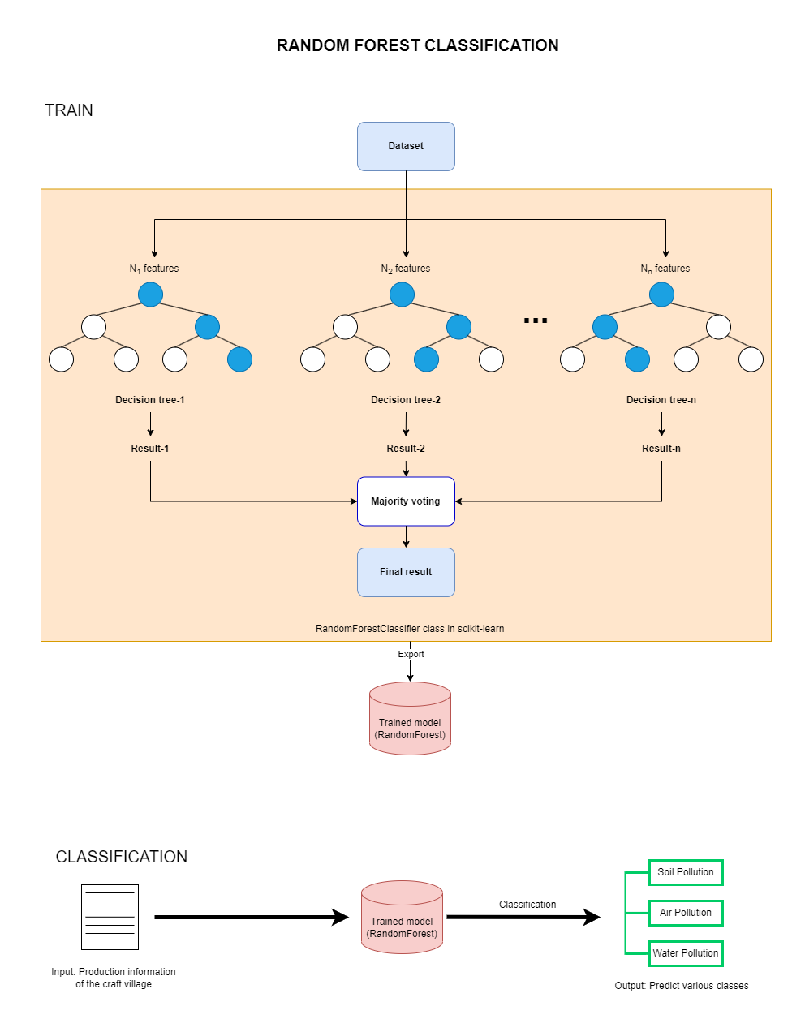
RANDOM FOREST

Slide 36
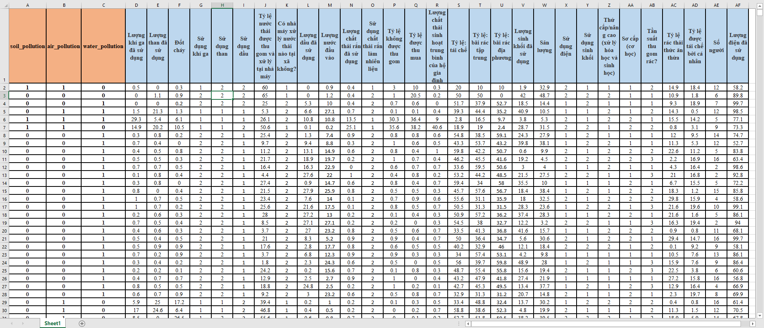
RANDOM FOREST

Slide 37
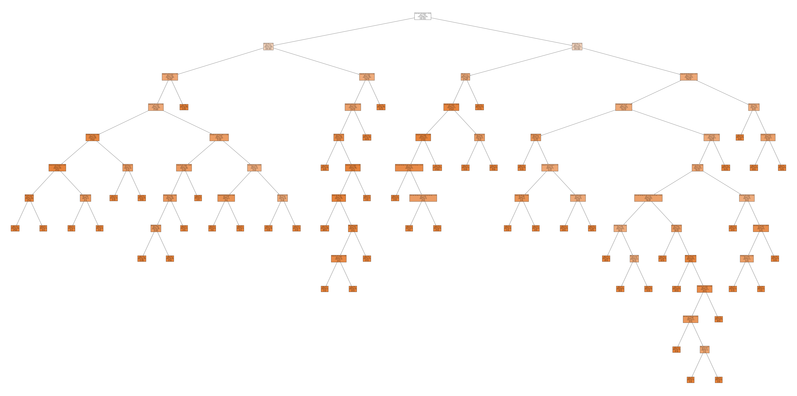
RANDOM FOREST

Slide 38
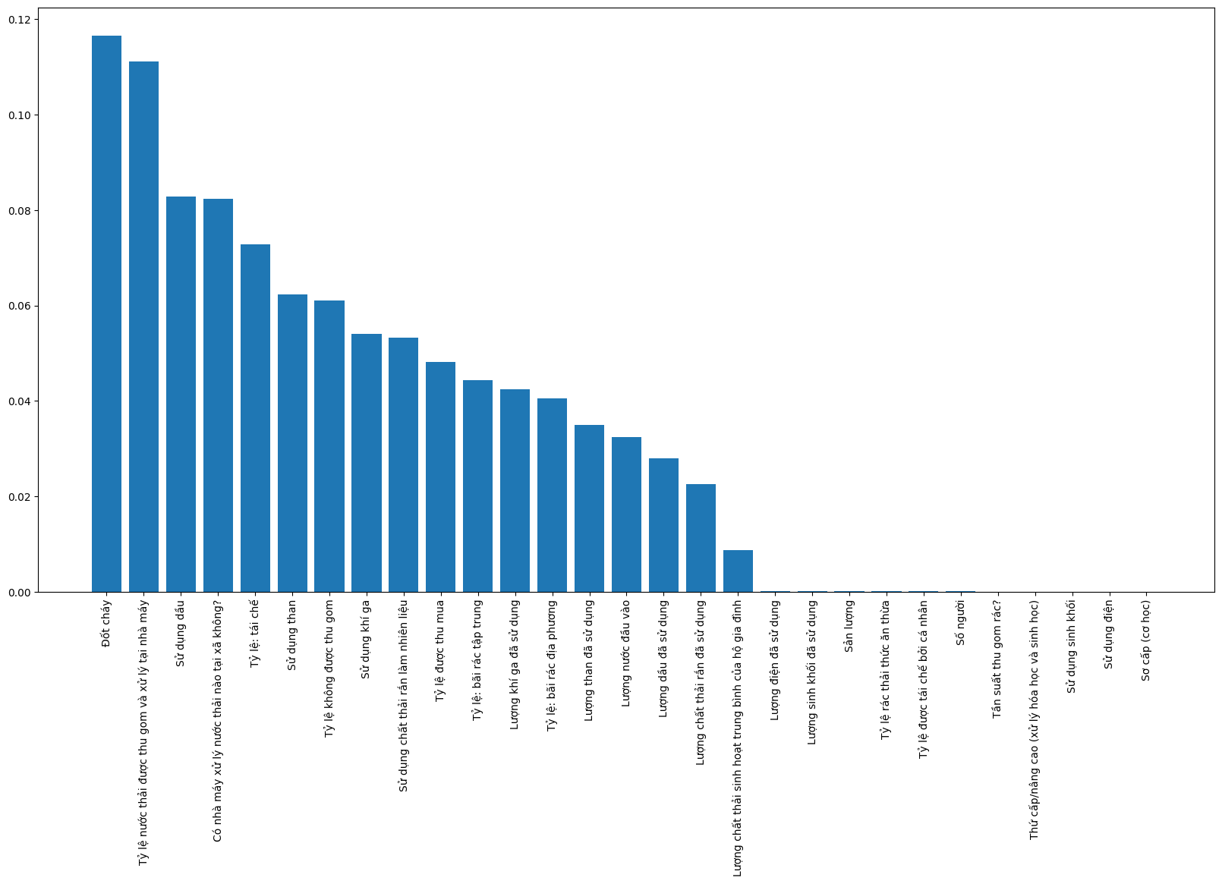
RANDOM FOREST

Slide 39
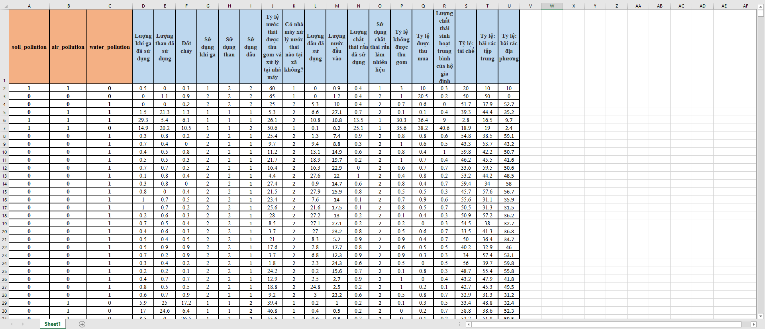
RANDOM FOREST

Slide 40
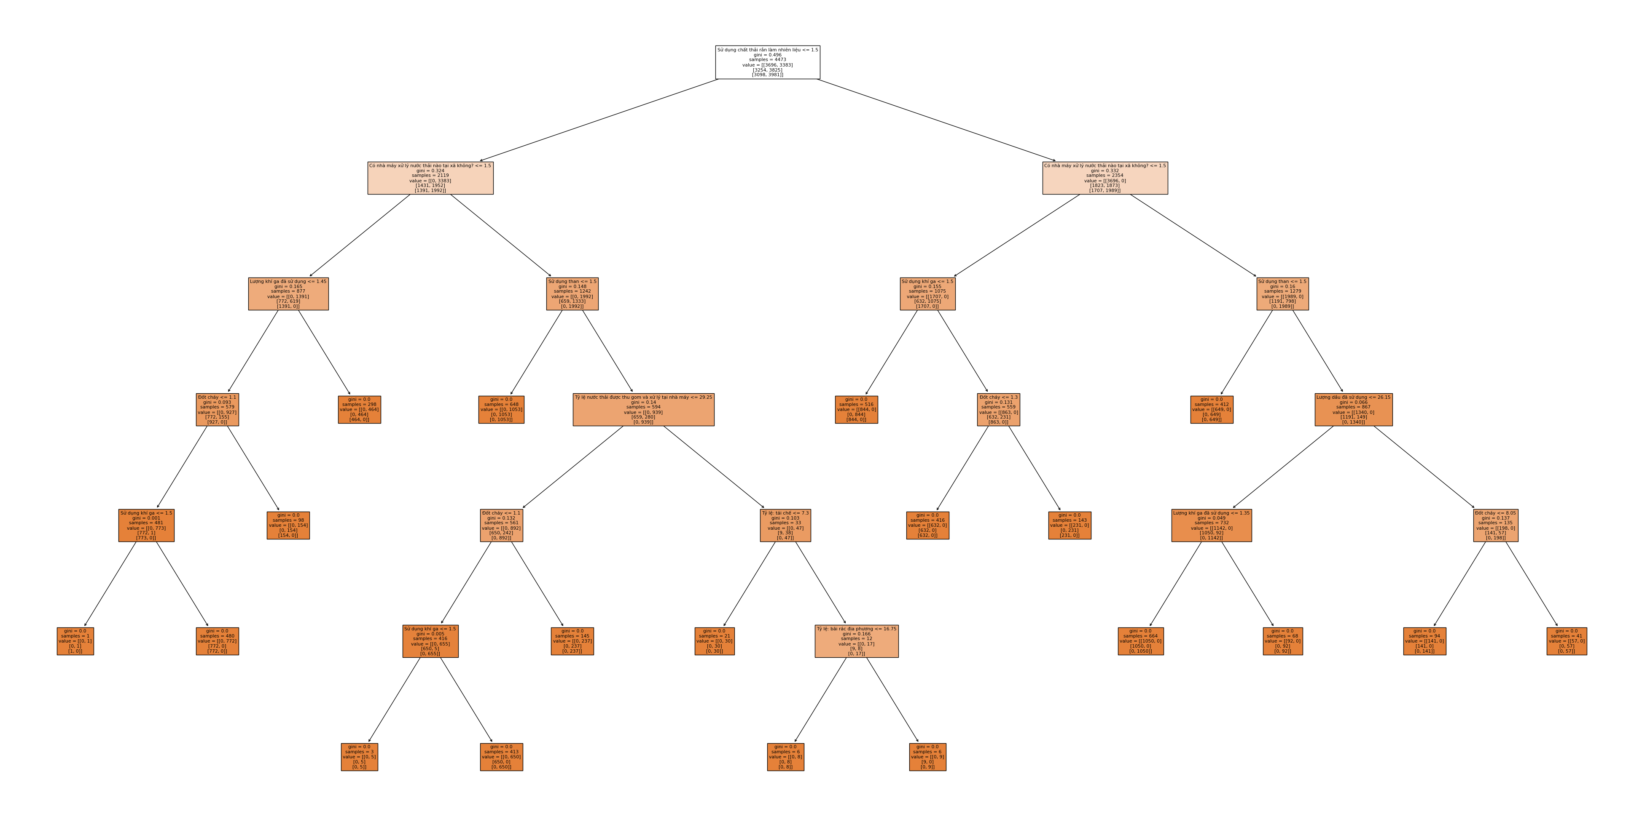
RANDOM FOREST

Slide 41
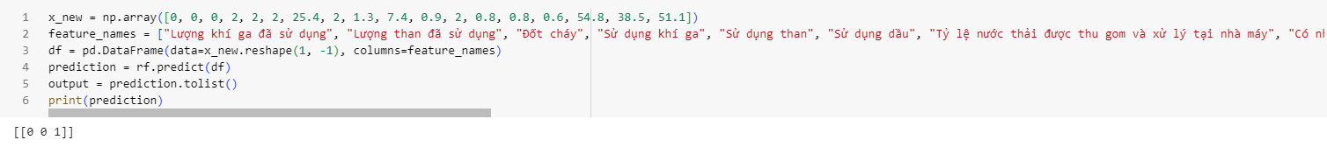
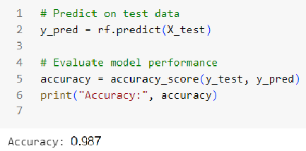
RANDOM FOREST

Slide 42
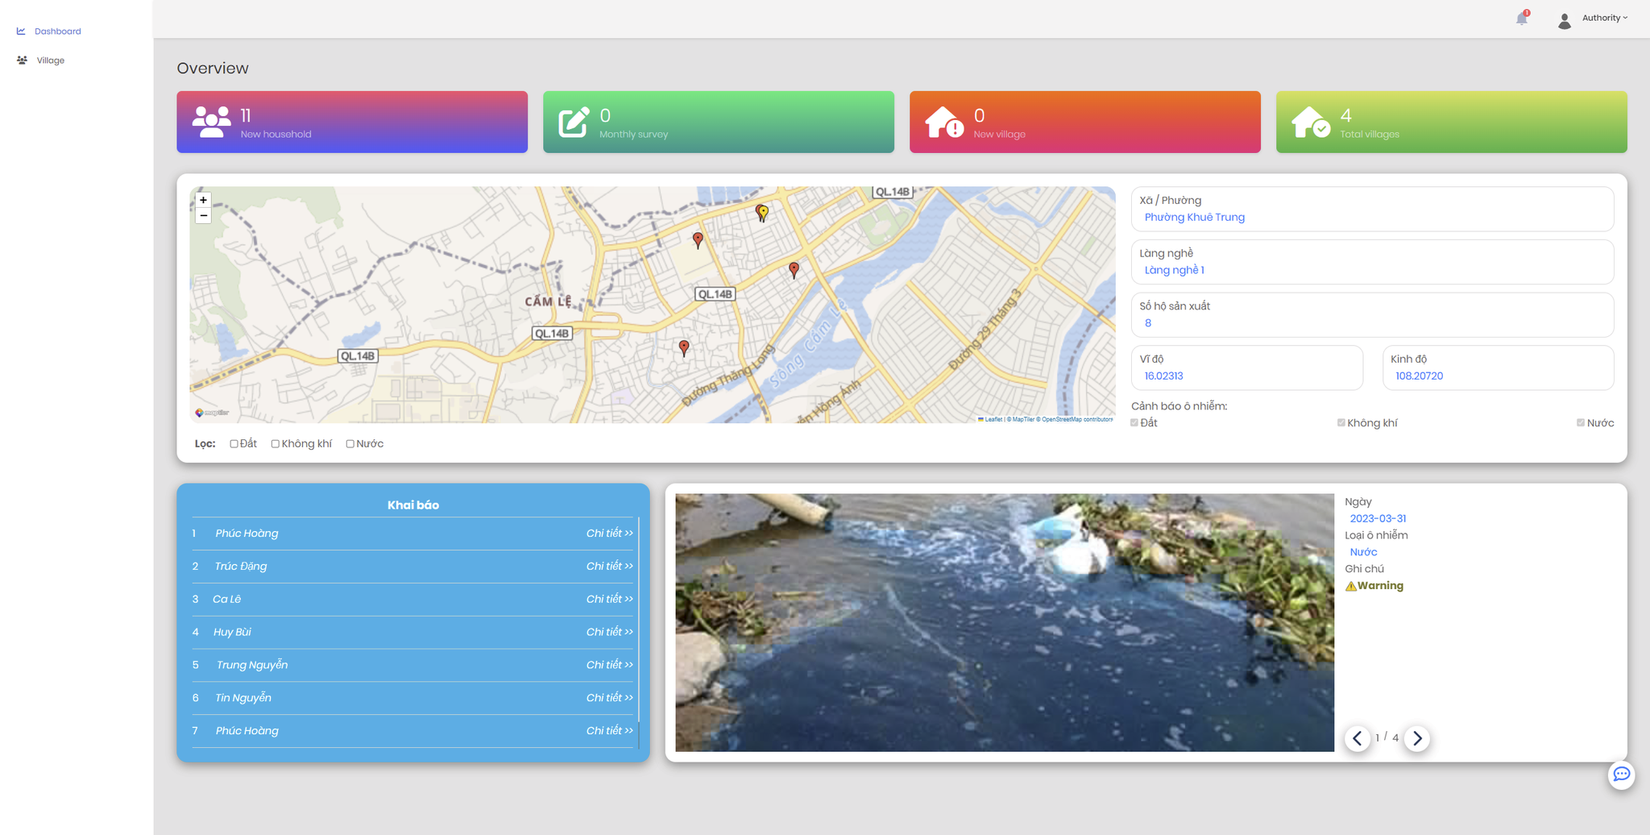

Slide 43
04
MANAGEMENT APPROACH
“The activist is not the man who says the river is dirty. The activist is the man who cleans up the river.”

Slide 44
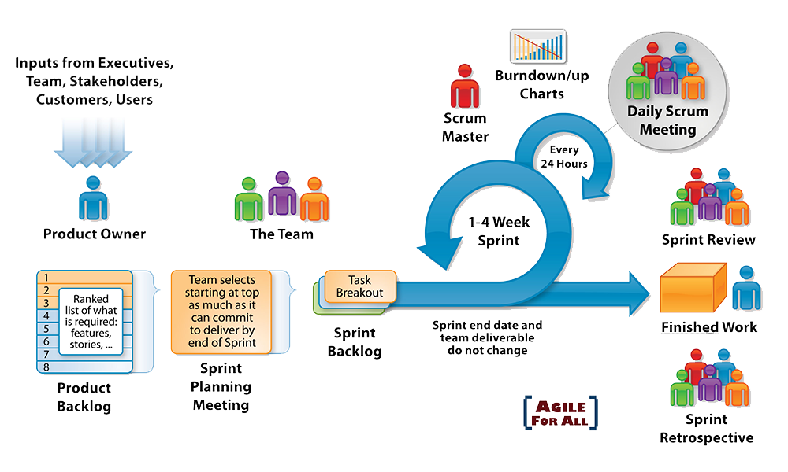
MANAGEMENT APPROACH

Slide 45
MANAGEMENT APPROACH
No. | Task Name | Start | Finish | Effort
1 | Initial | 21/02/2023 | 26/02/2023 | 28 hrs
1.1 | Gathering Requirement Meeting
1.2 | Analyze Requirement
2 | Create Document | 27/02/2023 | 01/03/2023 | 18 hrs
2.1 | Create Project Plan
2.2 | Create User Stories
2.3 | Create Product Backlog
3 | Development | 02/03/2023 | 16/05/2023 | 2140 hrs
3.1 | Sprint 1 | 02/03/2023 | 16/03/2023 | 428 hrs
3.2 | Sprint 2 | 18/03/2023 | 01/04/2023 | 428 hrs
3.3 | Sprint 3 | 02/04/2023 | 16/04/2023 | 428 hrs
3.4 | Sprint 4 | 17/04/2023 | 01/05/2023 | 428 hrs
3.5 | Sprint 5 | 02/05/2023 | 16/05/2023 | 428 hrs
3.8 | Review Project | 17/05/2023 | 17/05/2023 | 2 hrs

Slide 46
SPRINT 1
Sprint Id | Backlog Id | Description | Owner | Status | Estimate (Hours) | Completed | Pending | Total effort | Effort vs. Estimate | Day 0 | Day 1 | Day 2 | Day 3 | Day 4 | Day 5 | Day 6 | Day 7 | Day 8 | Day 9 | Day 10 | Day 11 | Day 12 | Day 13 | Day 14
1.1 | PB10 | [FE] Design Web layout | Phuc | Done | 25 | 25 | 0 | 20 | -5 |  |  |  |  | 25
1.2 | PB10 | [FE] Design UX/UI Login Page For Web Application | Trung | Done | 15 | 15 | 0 | 15 | 0 |  |  |  | 15
1.3 | PB10 | [FE] Design UX/UI Home Page For Web Application | Trung | Done | 15 | 15 | 0 | 15 | 0 |  |  |  |  |  | 15
1.4 | PB10 | [FE] Code UX/UI Login Page For Web Application | Nhan | Done | 10 | 10 | 0 | 10 | 0 |  | 10
1.5 | PB10 | [FE] Code UX/UI Home Page For Web Application | Nhan | Done | 10 | 10 | 0 | 7 | -3 |  |  | 10
1.6 | PB11 | [FE] Code Login Function For Web Application | Phuc | Done | 8 | 8 | 0 | 5 | -3 |  |  |  |  |  | 8
1.7 | PB11 | [FE] Code Logout Function For Web Application | Phuc | Done | 3 | 3 | 0 | 2 | -1 |  |  |  |  |  | 3
1.8 | PB10 | [FE] Design UX/UI Register Page For Web Application | Trung | Done | 15 | 15 | 0 | 13 | -2 |  |  |  |  |  |  | 15
1.9 | PB10 | [FE] Code UX/UI Register Page For Web Application | Nhan | Done | 15 | 15 | 0 | 10 | -5 |  |  |  | 15
1.10 | PB10 | [FE] Code Register Function For Web Application | Phuc | Done | 25 | 25 | 0 | 15 | -10 |  |  |  |  |  |  | 25
1.11 | PB14 | [AI] Research Method To Improve AI | Huy | Done | 30 | 30 | 0 | 30 | 0 |  |  |  |  | 30
1.12 | PB14 | [AI] Crawl Data For Improve AI | Huy | Done | 30 | 30 | 0 | 30 | 0 |  |  |  |  |  |  |  |  |  |  |  | 30
1.13 | PB17 | [FE] Code Change Language For Mobile Application | Ca | Done | 25 | 25 | 0 | 30 | 5 |  |  |  |  |  | 25
1.14 | PB16 | [FE] Research Method To Publish Application | Ca | Done | 25 | 25 | 0 | 15 | -10 |  |  |  |  |  |  |  |  | 25
1.15 | PB16 | [FE] Config Application For Publish Application | Ca | Done | 15 | 15 | 0 | 10 | -5 |  |  |  |  |  |  |  |  |  |  | 15
1.16 | PB16 | [FE] Publish Application To Google Play | Ca | Done | 10 | 10 | 0 | 8 | -2 |  |  |  |  |  |  |  |  |  |  |  |  | 10
1.17 | PB02 | [BE + DB] Create Question, Question Answer, Household Survey Entity | Phuc | Done | 10 | 10 | 0 | 8 | -2 |  |  |  |  |  |  |  |  | 10
1.18 | PB12 | [FE] Code & Design UX/UI Change Password For Web Application | Trung | Done | 15 | 15 | 0 | 12 | -3 |  |  |  |  |  |  |  |  |  | 15
1.19 | PB19 | [FE] Code & Design UX/UI Forget Password For Web Application | Phuc | Done | 15 | 15 | 0 | 9 | -6 |  |  |  |  |  |  |  |  |  |  |  |  | 15
1.20 | PB18 | [BD] Change Oracle Database to MySQL Database | Nhan | Done | 25 | 25 | 0 | 27 | 2 |  |  |  |  |  |  |  |  |  |  |  |  |  |  | 25
 |  |  |  | Total | 341 | 341 | 0 | 291 | -50 | 0 | 10 | 10 | 30 | 55 | 51 | 40 | 0 | 35 | 15 | 15 | 30 | 25 | 0 | 25
 |  |  |  | Burn down |  |  |  |  |  | 341 | 331 | 321 | 291 | 236 | 185 | 145 | 145 | 110 | 95 | 80 | 50 | 25 | 25 | 0
 |  |  |  | Ideal Burn down |  |  |  |  |  | 341 | 317 | 292 | 268 | 244 | 219 | 195 | 171 | 146 | 122 | 97 | 73 | 49 | 24 | 0

Slide 47
SPRINT 1

Slide 48
SPRINT 2
Sprint Id | Backlog Id | Description | Owner | Status | Estimate (Hours) | Completed | Pending | Total effort | Effort vs. Estimate | Day 0 | Day 1 | Day 2 | Day 3 | Day 4 | Day 5 | Day 6 | Day 7 | Day 8 | Day 9 | Day 10 | Day 11 | Day 12 | Day 13 | Day 14
2.1 | PB13 | [FE] Code & Design UX/UI Add New Local Authority For Web Application(Admin page) | Trung | Done | 15 | 15 | 0 | 10 | -5 |  |  | 15
2.2 | PB21 | [FE] Design Web layout (Household, Local Authority, Admin) | Phuc | Done | 20 | 20 | 0 | 18 | -2 |  |  |  | 20
2.3 | PB01 | [FE] Design UX/UI Report Form For Web Application | Phuc | Done | 10 | 10 | 0 | 8 | -2 |  |  |  |  | 10
2.4 | PB01 | [FE] Code Report API | Phuc | Done | 15 | 15 | 0 | 12 | -3 |  |  |  |  |  | 15
2.5 | PB01 | [FE] Code Report Logic For Web Application | Nhan | Done | 15 | 15 | 0 | 17 | 2 |  |  | 15
2.6 | PB02 | [BE] Code Question Api | Phuc | Done | 20 | 20 | 0 | 22 | 2 |  |  |  |  |  |  |  | 20
2.7 | PB02 | [BE] Code Question Answer Api | Phuc | Done | 10 | 10 | 0 | 12 | 2 |  |  |  |  |  |  |  |  |  | 10
2.8 | PB02 | [FE] Design Household Survey | Nhan | Done | 5 | 5 | 0 | 4 | -1 |  |  |  |  |  | 5
2.9 | PB02 | [FE] Code Declare Household Survey | Nhan | Done | 10 | 10 | 0 | 15 | 5 |  |  |  |  |  |  | 10
2.10 | PB22 | [FE] Design UX/UI Accept/Decline New Village Page For Web Application | Trung | Done | 5 | 5 | 0 | 6 | 1 |  |  |  |  | 10
2.11 | PB22 | [FE] Code UX/UI Accept/Decline New Village Page For Web Application | Phuc | Done | 10 | 10 | 0 | 8 | -2 |  |  |  |  |  |  |  |  |  |  | 5
2.12 | PB03 | [FE] Design UX/UI Dashboard Page For Web Application | Nhan | Done | 5 | 5 | 0 | 6 | 1 |  |  |  |  |  |  |  | 5
2.13 | PB03 | [FE] Code UX/UI Dashboard Page For Web Application | Nhan | Done | 10 | 10 | 0 | 7 | -3 |  |  |  |  |  |  |  |  |  | 10
2.14 | PB03 | [FE] Design UX/UI Declare Page For Web Application (Household) | Trung | Done | 5 | 5 | 0 | 6 | 1 |  |  |  |  |  | 5
2.15 | PB03 | [FE] Code UX/UI Declare Page For Web Application (Household) | Phuc | Done | 10 | 10 | 0 | 11 | 1 |  |  |  |  |  |  |  |  |  |  |  |  | 10
2.16 | PB14 | [AI] Retrain AI Model | Huy | Done | 30 | 30 | 0 | 35 | 5 |  |  |  |  |  | 30
2.17 | PB14 | [AI] Research Deploy Model To Server | Huy | Done | 20 | 20 | 0 | 17 | -3 |  |  |  |  |  |  |  |  |  |  |  | 20
2.18 | PB14 | [AI] Deploy Model To Server | Huy | Done | 5 | 5 | 0 | 3 | -2 |  |  |  |  |  |  |  |  |  |  |  |  | 5
2.19 | PB17 | [FE] Update Change Language Function | Ca | Done | 30 | 30 | 0 | 24 | -6 |  |  |  |  |  |  |  |  | 30
2.20 | PB20 | [FE] Update Craft Page | Ca | Done | 20 | 20 | 0 | 15 | -5 |  |  |  |  |  |  |  |  |  |  |  |  | 20
2.21 | PB16 | [FE] Deploy New Version To Store | Ca | Done | 2 | 2 | 0 | 3 | 1 |  |  |  |  |  |  |  |  |  |  |  |  |  |  | 2
 |  |  |  | Total | 272 | 272 | 0 | 259 | -13 | 0 | 0 | 30 | 20 | 20 | 55 | 10 | 25 | 30 | 20 | 5 | 20 | 35 | 0 | 2
 |  |  |  | Burn down |  |  |  |  |  | 272 | 272 | 242 | 222 | 202 | 147 | 137 | 112 | 82 | 62 | 57 | 37 | 2 | 2 | 0
 |  |  |  | Ideal Burn down |  |  |  |  |  | 272 | 253 | 233 | 214 | 194 | 175 | 155 | 136 | 117 | 97 | 78 | 58 | 39 | 19 | 0

Slide 49
SPRINT 2

Slide 50
SPRINT 3
Sprint Id | Backlog Id | Description | Owner | Status | Estimate (Hours) | Completed | Pending | Total effort | Effort vs. Estimate | Day 0 | Day 1 | Day 2 | Day 3 | Day 4 | Day 5 | Day 6 | Day 7 | Day 8 | Day 9 | Day 10 | Day 11 | Day 12 | Day 13 | Day 14
3.1 | PB05 | [FE] Design Edit Village Page | Phuc | Done | 20 | 20 | 0 | 18 | -2 |  |  |  |  | 20
3.2 | PB05 | [FE] Implement Map | Nhan | Done | 30 | 30 | 0 | 40 | 10 |  |  |  |  |  |  |  |  |  | 30
3.3 | PB05 | [FE] Code Edit Village Feature | Phuc | Done | 20 | 20 | 0 | 25 | 5 |  |  |  |  |  |  | 20
3.4 | PB05 | [BE] Code Update Village API | Phuc | Done | 20 | 20 | 0 | 15 | -5 |  |  |  |  |  |  | 20
3.5 | PB04 | [AI] Research Prediction AI | Huy | Done | 30 | 30 | 0 | 35 | 5 |  |  |  |  |  |  | 30
3.6 | PB04 | [AI] Research API For Prediction AI | Huy | Done | 30 | 30 | 0 | 32 | 2 |  |  |  |  |  |  |  |  |  |  |  |  |  |  | 30
3.7 | PB04 | [AI] Create Data For Prediction AI | Trung | Done | 60 | 60 | 0 | 70 | 10 |  |  |  |  |  |  |  |  |  |  |  |  |  |  | 60
3.8 | PB20 | [FE] Research Image Standard And Tags | Ca | Done | 30 | 30 | 0 | 32 | 2 |  |  |  |  |  |  | 30
3.9 | PB20 | [FE] Attach GPS Tags For Image | Ca | Done | 30 | 30 | 0 | 25 | -5 |  |  |  |  |  |  |  |  |  |  |  |  |  | 30
3.10 | PB18 | [BE] Deploy Backend To Server | Nhan | Done | 30 | 30 | 0 | 35 | 5 |  |  |  |  |  |  |  |  |  |  |  |  |  |  | 30
 |  |  |  | Total | 300 | 300 | 0 | 327 | 27 | 0 | 0 | 0 | 0 | 20 | 0 | 100 | 0 | 0 | 30 | 0 | 0 | 0 | 30 | 120
 |  |  |  | Burn down |  |  |  |  |  | 300 | 300 | 300 | 300 | 280 | 280 | 180 | 180 | 180 | 150 | 150 | 150 | 150 | 120 | 0
 |  |  |  | Ideal Burn down |  |  |  |  |  | 300 | 279 | 257 | 236 | 214 | 193 | 171 | 150 | 129 | 107 | 86 | 64 | 43 | 21 | 0

Slide 51
SPRINT 3

Slide 52
SPRINT 4
Sprint Id | Backlog Id | Description | Owner | Status | Estimate (Hours) | Completed | Pending | Total effort | Effort vs. Estimate | Day 0 | Day 1 | Day 2 | Day 3 | Day 4 | Day 5 | Day 6 | Day 7 | Day 8 | Day 9 | Day 10 | Day 11 | Day 12 | Day 13 | Day 14
4.1 | PB06 | [BE + DB] Code DataSet Entity | Phuc | Done | 20 | 20 | 0 | 15 | -5 |  |  |  | 20
4.2 | PB04 | [AI] Create Data For Prediction AI | Trung | Done | 60 | 60 | 0 | 80 | 20 |  |  |  |  |  |  |  |  |  |  |  |  |  |  | 60
4.3 | PB06 | [BE] Code DataSet API | Phuc | Done | 20 | 20 | 0 | 16 | -4 |  |  |  |  |  |  | 20
4.4 | PB06 | [DB] Generate Store Procedure Update DataSet | Phuc | Done | 30 | 30 | 0 | 25 | -5 |  |  |  |  |  |  |  |  |  |  | 30
4.5 | PB06 | [AI] Process Data For AI Trainning | Nhan | Done | 20 | 20 | 0 | 23 | 3 |  |  | 20
4.6 | PB04 | [AI] Train Prediction AI Model | Huy | Done | 30 | 30 | 0 | 30 | 0 |  |  |  |  |  | 30
4.7 | PB04 | [AI] Write API For Prediction AI | Huy | Done | 25 | 25 | 0 | 20 | -5 |  |  |  |  |  |  |  |  |  | 25
4.8 | PB18 | [AI] Deploy Model To Server | Huy | Done | 5 | 5 | 0 | 3 | -2 |  |  |  |  |  |  |  |  |  |  | 5
4.9 | PB05 | [BE] Layout Survey Marker on Map | Nhan | Done | 15 | 15 | 0 | 13 | -2 |  |  |  |  | 15
4.10 | PB20 | [FE] Attach GPS Tags For Image Using EXIF Standard | Ca | Done | 30 | 30 | 0 | 32 | 2 |  |  |  |  |  |  | 30
4.11 | PB20 | [FE] Update Craft Page | Ca | Done | 15 | 15 | 0 | 12 | -3 |  |  |  |  |  |  |  |  |  |  | 15
4.12 | PB05 | [FE] View Sumitted Survey | Nhan | Done | 20 | 20 | 0 | 15 | -5 |  |  |  |  |  |  |  | 20
4.13 | PB18 | [BE] Deploy New Backend Version To Server | Nhan | Done | 15 | 15 | 0 | 12 | -3 |  |  |  |  |  |  |  |  |  |  |  | 15
 |  |  |  | Total | 305 | 305 | 0 | 296 | -9 | 0 | 0 | 20 | 20 | 15 | 30 | 50 | 20 | 0 | 25 | 50 | 15 | 0 | 0 | 60
 |  |  |  | Burn down |  |  |  |  |  | 305 | 305 | 285 | 265 | 250 | 220 | 170 | 150 | 150 | 125 | 75 | 60 | 60 | 60 | 0
 |  |  |  | Ideal Burn down |  |  |  |  |  | 305 | 283 | 261 | 240 | 218 | 196 | 174 | 153 | 131 | 109 | 87 | 65 | 44 | 22 | 0

Slide 53
SPRINT 4

Slide 54
SPRINT 5
Sprint Id | Backlog Id | Description | Owner | Status | Estimate (Hours) | Completed | Pending | Total effort | Effort vs. Estimate | Day 0 | Day 1 | Day 2 | Day 3 | Day 4 | Day 5 | Day 6 | Day 7 | Day 8 | Day 9 | Day 10 | Day 11 | Day 12 | Day 13 | Day 14
5.1 | PB07 | [AI] Generate Training Data From Json | Huy | Done | 30 | 30 | 0 | 30 | 0 |  |  |  |  |  | 30
5.2 | PB07 | [AI] Implement New Model | Huy | Done | 30 | 30 | 0 | 30 | 0 |  |  |  |  |  |  |  |  |  |  |  |  | 30
5.3 | PB07 | [FE] Code Update Required Question Feature | Nhan | Done | 20 | 20 | 0 | 25 | 5 |  |  |  |  | 20
5.4 | PB08 | [BE] Code Get Data Set API | Phuc | Done | 20 | 20 | 0 | 15 | -5 |  |  | 20
5.5 | PB08 | [BE] Code Call Predict API With Data Set | Phuc | Done | 20 | 20 | 0 | 12 | -8 |  |  |  |  |  |  |  |  | 20
5.6 | PB02 | [BE] Refactor Question and Question Answer and Household Survey | Phuc | Done | 10 | 10 | 0 | 15 | 5 |  |  |  |  |  |  |  |  |  | 10
5.7 | PB08 | [FE] Code Download Data Set Feature For Web Application | Nhan | Done | 20 | 20 | 0 | 18 | -2 |  |  |  |  |  |  |  |  | 20
5.8 | PB09 | [BE] Code Notification API | Phuc | Done | 10 | 10 | 0 | 12 | 2 |  |  |  |  |  |  |  |  |  |  | 10
5.9 | PB09 | [FE] Code Notification Feature | Nhan | Done | 20 | 20 | 0 | 25 | 5 |  |  |  |  |  |  |  |  |  |  |  |  | 20
5.10 | PB18 | [AI] Deploy Model To Server | Huy | Done | 5 | 5 | 0 | 6 | 1 |  |  |  |  |  |  |  |  |  |  |  |  |  | 5
5.11 | PB18 | [BE] Deploy Backend To Server | Nhan | Done | 15 | 15 | 0 | 10 | -5 |  |  |  |  |  |  |  |  |  |  |  |  |  |  | 15
5.12 | PB16 | [FE] Code Fillter For Pollution Types | Phuc | Done | 15 | 15 | 0 | 12 | -3 |  |  |  |  |  |  |  |  |  |  |  |  |  | 15
5.13 | PB15 | [FE] Deploy New Version To Store | Ca | Done | 3 | 3 | 0 | 2 | -1 |  | 3
 |  |  |  | Total | 218 | 218 | 0 | 212 | -6 | 0 | 3 | 20 | 0 | 20 | 30 | 0 | 0 | 40 | 10 | 10 | 0 | 50 | 20 | 15
 |  |  |  | Burn down |  |  |  |  |  | 218 | 215 | 195 | 195 | 175 | 145 | 145 | 145 | 105 | 95 | 85 | 85 | 35 | 15 | 0
 |  |  |  | Ideal Burn down |  |  |  |  |  | 218 | 202 | 187 | 171 | 156 | 140 | 125 | 109 | 93 | 78 | 62 | 47 | 31 | 16 | 0

Slide 55
SPRINT 5

Slide 56
COMMUNICATION METHODOLOGY
Audience/ Attendees | Topic/ Deliverable | Frequency | Method
Mentor and Team member | Project Progress Review | Weekly | Skype Meeting
Team Member | Project Progress Review and Daily Meeting | Every 2-3 days | Remotely, Face to Face

Slide 57
MANAGEMENT
No | Tool | Content
1 | Trello/Excel | Track member activities.
2 | Google Document | Track the changing of documents & manage versions of documents.
3 | GitHub | Repositories for source code version management
4 | Weekly Meeting | Hold a meeting every week to assign tasks to each member. If there are some emergencies but we cannot sit together then we can use Facebook to discuss online.
5 | Google Drive | Store document resources and designed components
6 | Messenger | Discuss online, stream and share problems

Slide 58
BUDGET
No | Criteria | Price | Amount | Total (USD)
1 | Working hours | $ 2 | 2188 | $ 4376
2 | Online server and services | $ 100 | 5 | $ 500
3 | Party | $ 150 | 2 | $ 300
Total cost |  |  |  | $ 5176

Slide 59
BUDGET USING COCOMO
Phase | Effort (Person-months) | Schedule (Months) | Average Staff | Cost (Dollars)
Inception | 0.9 | 1.1 | 0.8 | $307
Elaboration | 3.5 | 3.2 | 1.1 | $1229
Construction | 11.1 | 5.3 | 2.1 | $3890
Transition | 1.8 | 1.1 | 1.6 | $614

Slide 60
05
DEMONSTRATION
“Be part of the solution, not part of the pollution.”

Slide 61
THANK YOU

